Slide 1
Machine Learning on Azure Databricks - workshop

Slide 2
About the lab

Slide 3



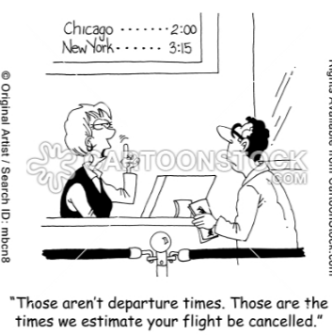

Use case and algorithm
flight delay prediction
random forest classification
supervised learning

Slide 4




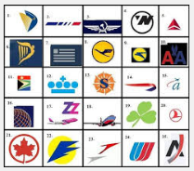
Datasets
Flight data
[history] 44MB CSV, [4-6]/2013
Weather data [history]
43MV CSV
Public datasets
Airport data
6K
Carrier/airline data
16

Slide 5
Lab - tasks
Ingest
Train model
Batch predict
Feature engineer
Read source data from Azure Blob Storage and Azure SQL Database
Profile raw data, visualize, cleanse, transform, identify features of interest, create model input dataset
Train model, test model, tune model (hyper parameter tuning and cross validation), review feature importance, persist model
Leverage the pre-trained model in a batch prediction process, automate the prediction process into a scheduled batch job

Slide 6
Azure Databricks
Provisioning, configuration, lab prep

Slide 7

Provisioning TODOs
Create a resource group in US East 2
Provision Azure Blob Storage in the resource group
Provision Azure SQL Database in the resource group (100 DTU)
Provision Azure Databricks workspace in the resource group
Provision a cluster in the Databricks workspace
Instructions: https://aka.ms/mllab-provisioning
Note down: Storage account name, key
Database server name, UID, password

Slide 8
Data load TODOs
Install Azure Storage Explorer
Download data for the workshop
Create blob storage containers
Upload data into staging directory
Instructions: https://aka.ms/mllab-provisioning

Slide 9

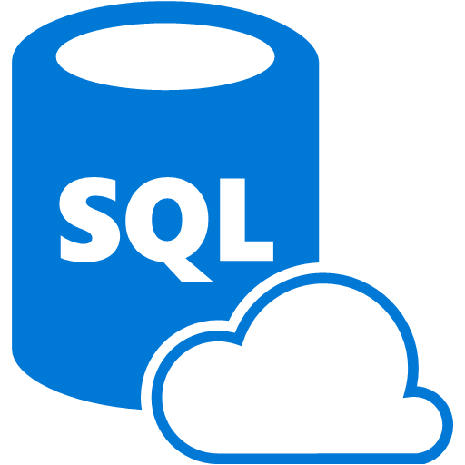

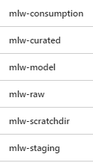
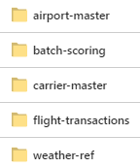
By now…
You should have the following set up in your subscription:
resourceGroup
Containers
Workshop data

Slide 10
Hands on lab - Module 1
Azure Databricks setup, exploration & 101 of working with storage

Slide 11
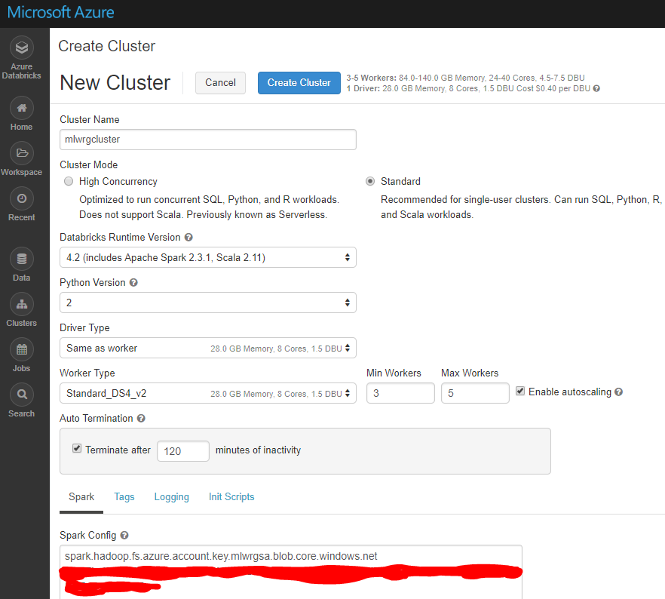
Provision cluster Azure Databricks – setup
Initialize workspace and create a cluster with the following specifications:
In the Spark config section, enter your storage account credentials-
spark.hadoop.fs.azure.account.key.<storageaAccount>.blob.core.windows.net <key>
The credentials are needed at a cluster level to access the “Data” view of Databricks &
for security

Slide 12
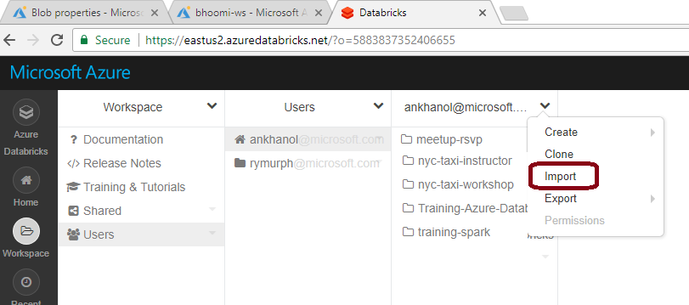
Import Notebooks Workshop – setup

Slide 13
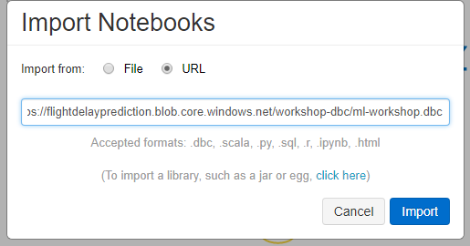
Import Notebooks Workshop – setup
https://aka.ms/aiddmllab

Slide 14
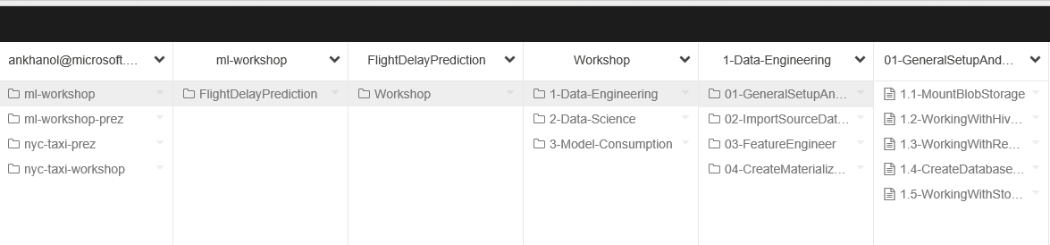
Import Notebooks Workshop – setup

Slide 15
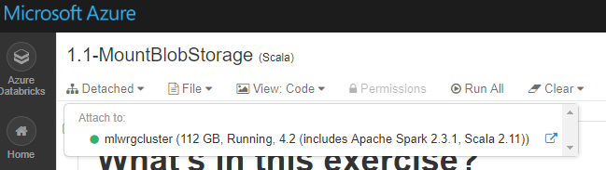
Mount blob storage Azure Databricks – setup
require credentials – no anonymous access
Go to the notebook: ml-workshop/FlightDelayPrediction/Workshop/1-Data-Engineering/01-GeneralSetupAnd101/1.1-MountBlobStorage.scala
Attach Spark cluster to notebook
Substitute the storage account name
Execute the notebook

Slide 16
Working with Hive, SparkSQL Azure Databricks – How to
In this workbook, we will learn how to define a Hive schema over structured data in DBFS, and query using SQL
Go to the notebook ml-workshop/FlightDelayPrediction/Workshop/1-Data-Engineering/01-GeneralSetupAnd101/1.2-WorkingWithHiveAndSQL.scala
Execute the notebook

Slide 17
Working with remote database/JDBC Azure Databricks – How to
In this workbook, we will learn how to define a Hive table in Databricks for a remote databases over JDBC and query it
Go to the notebook ml-workshop/FlightDelayPrediction/Workshop/1-Data-Engineering/01-GeneralSetupAnd101/1.3-WorkingWithRemoteDatabases.scala
Use following parameters
url: jdbc:sqlserver://demodbsrvraa.database.windows.net:1433;database=demodb
dbtable 'us_states',
user 'demodbadmin',
password 'd@t@br1ck$’
Execute the notebook

Slide 18
Create database objects Azure Databricks – setup
We will be working with structured data, and will create Hive external tables so we can use the Spark dataframe API/SparkSQL for data processing wherever possible
Go to the notebook: ml-workshop/FlightDelayPrediction/Workshop/1-Data-Engineering/01-GeneralSetupAnd101/1.4-CreateDatabaseObjects.scala
Execute the notebook

Slide 19
Working with storage Azure Databricks – How to
In this workbook, we will learn how to work with DataBricksFileSystem backed by Azure blob storage – upload, copy, delete etc.
Go to the notebook ml-workshop/FlightDelayPrediction/Workshop/1-Data-Engineering/01-GeneralSetupAnd101/1.5-WorkingWithStorage.scala
Execute the notebook

Slide 20
In this module..
We completed-
Provisioning a cluster in the Databricks workspace
Imported the workshop notebooks into the workspace
Mounted blob storage
Create a database and executed external table definitions
101 on working with blob storage, remote Azure SQL database, Hive and SQL

Slide 21
Hands on lab - Module 2
Import datasets for the lab

Slide 22
Import carrier master data
Go to the notebook: ml-workshop/FlightDelayPrediction/Workshop/1-Data-Engineering/02-ImportSourceDatasets/2.2-ImportCarrierData.scala
In this workbook, we will - 1) Import carrier source data from the staging directory into the raw directory 2) Create a Hive external table on top of it 3) Compute statistics 4) Explore the dataset
Execute the notebook

Slide 23
Import airport master data
Go to the notebook: ml-workshop/FlightDelayPrediction/Workshop/1-Data-Engineering/02-ImportSourceDatasets/2.1-ImportAirportData.scala
In this workbook, we will - 1) Import airport source data from the staging directory into the raw directory 2) Create a Hive external table on top of it 3) Compute statistics 4) Explore the dataset
Execute the notebook
Notes:
%sql
USE flight_db;
DROP TABLE IF EXISTS airport_master;
CREATE EXTERNAL TABLE IF NOT EXISTS airport_master(
airport_id INT,
airport_cd STRING,
airport_nm STRING,
airport_lat STRING,
airport_long STRING
)
ROW FORMAT DELIMITED
FIELDS TERMINATED BY ','
LOCATION '/mnt/data/mlw/rawDir/master-data/airport';

Slide 24
Import flight transactional data
Go to the notebook: ml-workshop/FlightDelayPrediction/Workshop/1-Data-Engineering/02-ImportSourceDatasets/2.4-ImportFlightData.scala
In this workbook, we will - 1) Import flight history source data from the staging directory into the raw directory 2) Create a Hive external table on top of it 3) Compute statistics 4) Explore the dataset
Execute the notebook

Slide 25
Import weather reference data
Go to the notebook: ml-workshop/FlightDelayPrediction/Workshop/1-Data-Engineering/02-ImportSourceDatasets/2.3-ImportWeatherData.scala
In this workbook, we will - 1) Import weather history source data from the staging directory into the raw directory 2) Create a Hive external table on top of it 3) Compute statistics 4) Explore the dataset
Execute the notebook

Slide 26
In this module..
1) Imported carrier master data, airport master data, weather reference data and flight transactional data
2) Created Hive tables for each
3) Computed statistics for each table
4) Profiled each dataset
5) Learned basics of visualizing in Databricks

Slide 27
Hands on lab - Module 3
Profile and transform data in preparation

Slide 28
Attributes of interest Flight history dataset
Focus for predictions:
Departure delay (label) & subset attributes listed below Temporal identifiers: Year , Month, Day, Hour
Subset attributes: origin_airport_code month, day_of_month day_of_week dep_hour (derived) carrier_code dest_airport_code dep_del_15

Slide 29
Transformations Flight history dataset
Flight attribute | Transformation rule | In place/derived
Departure Delayed by 15 minutes | Delete records with missing values | N/A
Departure hour | Departure time/100 Rounded to nearest integer | Derived

Slide 30
Flight data transformation exercise
Go to the notebook-
ml-workshop/FlightDelayPrediction/Workshop/1-Data-Engineering/03-FeatureEngineer/3.2.FeatureEngineer-Flight.scala
In this exercise, we will - 1) Profile the flight history data and determine transformations needed 2) Transform the dataset into a dataset we will call flight_history_curated 3) Create a Hive table on top of it 4) Compute statistics for performance
Execute the notebook

Slide 31
Attributes of interest Weather history dataset
Focus for predictions:
Wind speed (miles per hour) Sea level pressure (in inches of mercury) Hourly precipitation (in inches)
Weather location identifiers: Latitude Longitude
Temporal identifiers: Year , Month, Day, Hour

Slide 32
Transformations Weather history dataset
Weather attribute | Transformation rule | Inplace/derived
Wind speed | Replace blanks with 0.0 Replace ‘M’ with 0.0 | In place
Sea level pressure | Replace blanks with 0.0 Replace ‘M’ with 29.92 | In place
Hourly precipitation | Replace blanks with 0.0 Replace ‘T’ with 0.05 | In place
Departure hour | Departure time/100 Rounded to nearest integer | Derived

Slide 33
Weather data transformation exercise
Go to the notebook: ml-workshop/FlightDelayPrediction/Workshop/1-Data-Engineering/03-FeatureEngineer/3.1-FeatureEngineer-Weather.scala
In this exercise, we will - 1) Profile the weather history data and determine transformations needed 2) Transform the dataset into a dataset we will call weather_history_curated
3) Create a Hive table on top of it 4) Compute statistics for performance
Execute the notebook

Slide 34
Hands on lab - Module 4
Create a materialized view

Slide 35
What is a materialized view?
In distributed computing, we join once, query many times – to use cluster resources including network, judiciously
In the RDBMS world, a view is a logical table that can be used to abstract query complexity or for security; Every time a view is queried, the underlying query (with joins if any) is executed. A materialized view on the other hand is a physical table created/refreshed on schedule.
A materialized view can be a denormalized dataset for performance optimization from a read perspective.

Slide 36
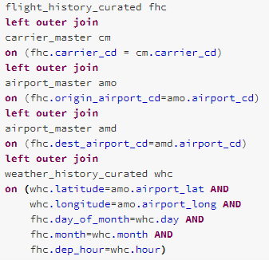
Joining the datasets
Flight data
Airport data
Airline Carrier data
Weather data
[left outer]
[left outer]
[inner join]

Slide 37
Materialized view creation exercise
Go to the notebook: ml-workshop/FlightDelayPrediction/Workshop/1-Data-Engineering/04-CreateMaterializedView/4.1.CreateMaterializedViews.scala
In this workbook, we will - 1) Join all 4 datasets into a common table & persist 2) Create a Hive table on top of it 3) Compute statistics for performance
Execute the notebook
JOIN

Slide 38
Hands on lab - Module 5
Create model input

Slide 39
Label & features In this specific order
Label:
dep_delay_15
Features:
origin_airport_id,flight_month,flight_day_of_month,flight_day_of_week,flight_dep_hour,carrier_indx,dest_airport_id,wind_speed,sea_level_pressure,hourly_precip

Slide 40
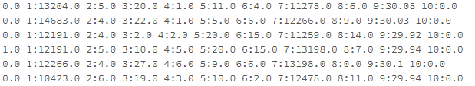
LibSVM format
About the format:
Sparse matrix format Input format for Spark ML algorithms
Input:
Data from the materialized view
Sample:

Slide 41
Exercise to create model input
Go to the notebook: ml-workshop/FlightDelayPrediction/Workshop/1-Data-Engineering/05-CreateModelInput/5.1-CreateModelTrainingInput.scala In this exercise, we will - 1) Read label and features identified 2) Create label and features index 3) Create a LabeledPoint RDD 4) Persist it as a LibSVM file
Execute the notebook

Slide 42
Hands on lab - Module 6
Train model, tune model

Slide 43
Train model
Go to the notebook:
ml-workshop/FlightDelayPrediction/Workshop/1-Data-Engineering/06-TrainModel/6.1a-TrainModel-RandomForest.scala
In this exercise, we will - 1) Read the model in LibSVM format into a dataframe 2) Split the data into training and test datasets 3) Train a random forest classifier model 4) Test the model against the test dataset split 5) Review feature importance 6) Persist the model
Execute the notebook

Slide 44
Tune the model Hyperparameter tuning and cross validation
Go to the notebook: ml-workshop/FlightDelayPrediction/Workshop/1-Data-Engineering/06-TrainModel/6.2-TrainAndTuneModel-RandomForest.scala
In this exercise, we will - 1) Read the model in LibSVM format into a dataframe 2) Split the data into training and test datasets 3) Create a parameter grid with an array of number of trees and tree depth 4) Specify the number of folds 5) Train a random forest classifier model 6) Test the model against the test dataset split 7) Compare metrics against model without the tuning we just did
Execute the notebook

Slide 45
Hands on lab - Module 7
Scoring

Slide 46
Scoring exercise Predict delays
Go to the notebook: ml-workshop/FlightDelayPrediction/Workshop/3-Model-Consumption/07-BatchPredictFlightDelays/7.1-BatchPredict.scala In this exercise, we will - 1) Read the data to be scored from blob storage 2) Prep the data for scoring 3) Load the model from DBFS 4) Extract predictions 5) Pipe results to an RDBMS
Execute the notebook
Pre-joined flight and weather data

Slide 47
Hands on lab - Module 8
Batch job automation

Slide 48
Batch job automation exercise Predict delays
In this exercise, we will - 1) Create a notebook to read scoring input from RDBMS and transform for predicting 2) Create a notebook that executes model predictions and persists scoring results to an RDBMS 3) Create a notebook workflow (called workflow) that invokes 1) and 2) sequentially 4) Create a batch job that executes the workflow on-demand/on schedule - on existing cluster or spawn new cluster at scheduled time
The notebooks are: ml-workshop/FlightDelayPrediction/Workshop/3-Model-Consumption/08-BatchJobPipeline/
LoadScoringRequestAndTransform.scala
ScoreAndPersist.scala
Workflow.scala
Execute the notebook – Workflow.scala to try out.
Pre-joined flight and weather data

Slide 49
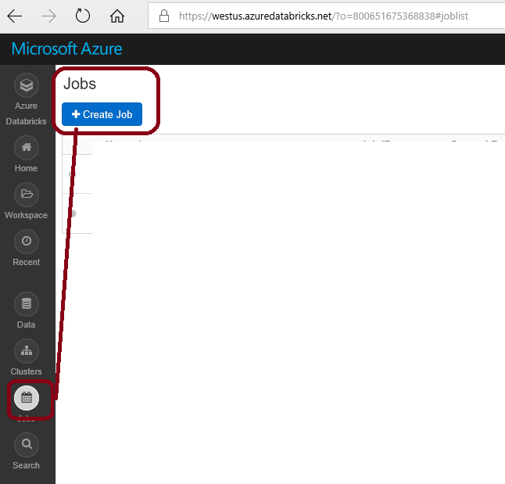
Batch job

Slide 50
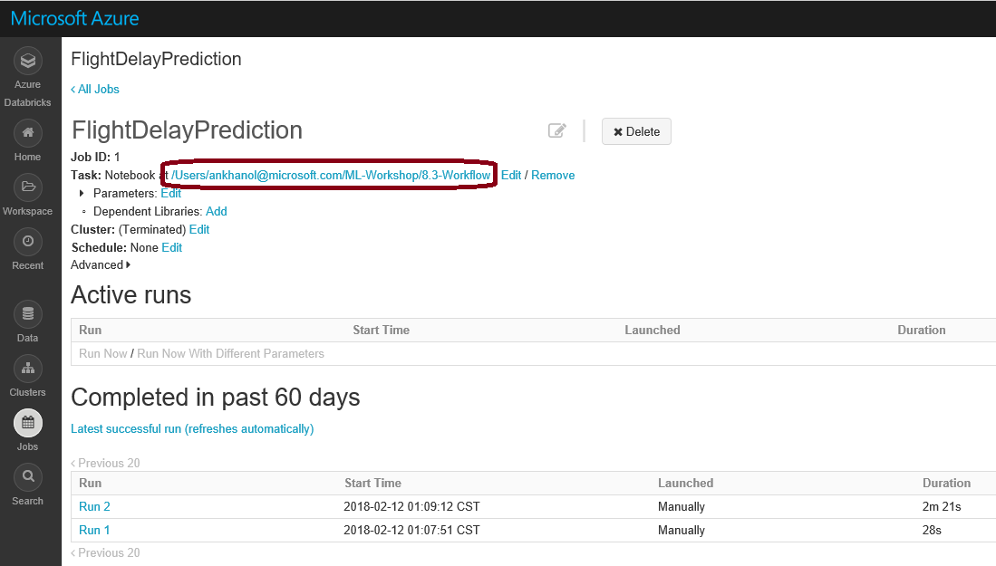

Slide 51
